Slide 1
Selena: a Serverless Energy Management System
Florian Huber Nikolai Koerber Markus Mock
Notes:
Good Morning
Landshut, Germany
This is joint work with Mr. …
Today I will present Selena: a …
First of all we will start with the motivation
Why do we need a EMS?

Slide 2
Motivation
Reduction of CO2
One third due to buildings
Energy management system(EMS) quickly become mandatory
Notes:
Reducing Co2 emission to prevent irreversible climate changes has become a major challenge faced by humanity today.
In developed countries, about ⅓ of carbon emissions are due to buildings.
Intelligent management of energy consumption and production by building as well as prediction of renewable energy production is an important part of this solution.
Also in some countries like Germany EMS are quickly becoming mandatory.
Building a EMS system needs three important features. ->

Slide 3
Motivation
Extensibility
Scalability
Maintainability
Notes:
Extensibility. It must be easily possible to use the system in heterogeneous environments with different hard or software than we currently do.
Scalability. For such system to be usable across a wide variety of environments, from single family homes, to whole cities or regions it must scale gracefully with the number of instrumentation points.
Maintainability. Since we want Selena to be usable in a variety of environments that differ both in their scale as well as the kinds of instrumentation that they employ, the codebase needs to easily maintainable.
Combining all these features we came up with the architecture for Selena ->

Slide 4
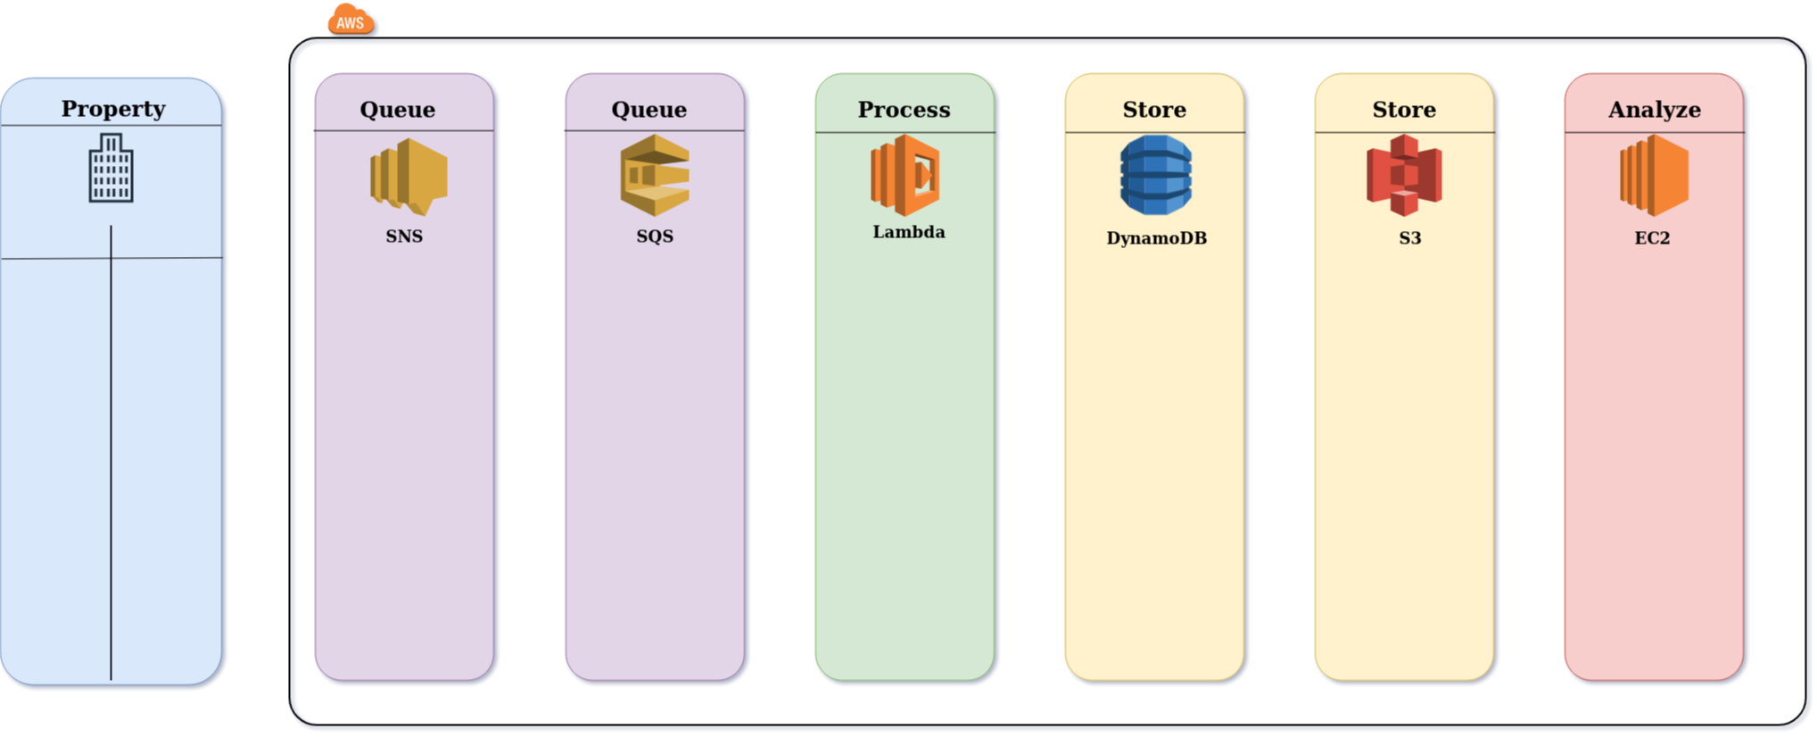
Key Components:
Property
Physical site
Data-producer
AWS
Queue
Process
Store
Analyze
Selena architecture overview.
Notes:
We separated Selena into two parts.
The cloud computing part which is hosted in AWS and the physical sites where energy- and resource-related data is produced, we call them properties.
Inside of AWS we grouped our process pipeline into four independent stages.
xxx
Before diving deeper into the aws backend lets have look where Selena is already deployed.
Speaking about sites and environments

Slide 5
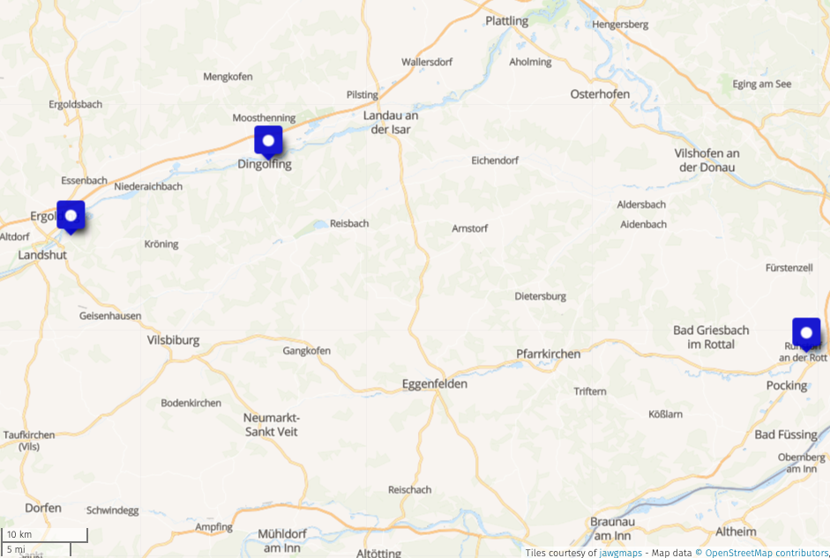
Property
Resource
Electricity
Water
Weather
PV
Heat
Overview of sites whose energy-related data is currently managed in Selena
Notes:
Our Selena EMS consists of three logical sites that are either part of the UAS Landshut or are affiliated project partners.
Starting with the UAS Landshut here, the Technology Center for logistic in Dingolfing here and the Technology Center Energy in Ruhstorf here.
Since not all sites produce the same types of data, each site needs a specific software package tailored to its sensors.
Currently we support theses resource types.
To make this feasible, we have taken care of create easily extensible data types to represent measurement data. ->

Slide 6
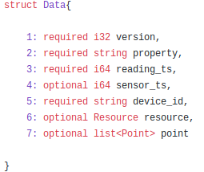
Data Representation
Representation as JSON
Thrift IDL
DataPaket
Data
Point
Extensible
Portable
Thrift Data struct implementation.
Notes:
To make our data representation extensible and portable we are using the Thrift IDL.
We are using three different Thrift types when transmitting data from the property to the selena backend.
Data Package, Data and Point, which are build upon each other.
Point is the simplest type and represents a single measurement and contains a double value and a unit, represented as an enum.
Data is the main type representing energy related measurements, shown here.
It contains a version number of the data type definition to allow for a graceful evolution of data types.
It also contains the site-unique device ID of the measurements device.
xxx
Updating for instance a resource type is easily possible without concurrently requiring an update of all measurement codes at the same time.
Due to the fact that we use enum types for the unit and resource, thrift allows us to be backwards compatible.
Data package is a simple boxing type, that contains a list of Data elements, and is used to provide batches of single measurements points, to reduce network traffic and transmission cost.
We are using the TJSON serializer which serializes the object into a JSON representation.
Talking about transmission how does the ingress pipeline for selena look like? ->

Slide 7
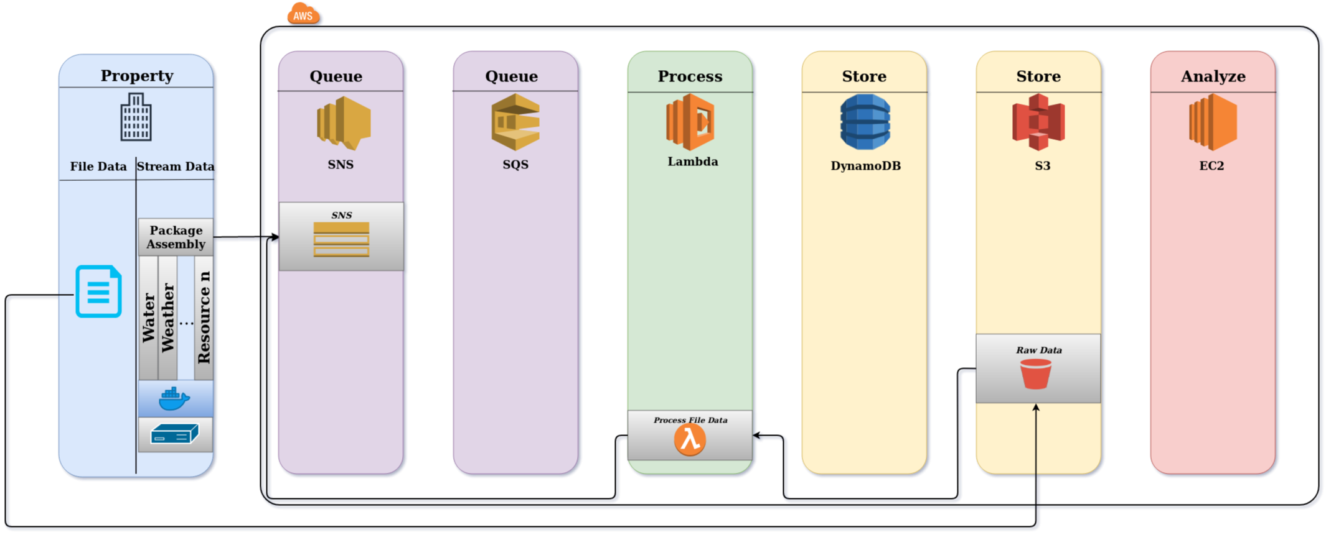
Ingress
Stream Data
Concentrator
Raspberry Pi
File Data
CSV
Excel
Selena architecture overview. Data produced at properties enter the system either via S3 bucket or through Selena’s SNS endpoint.
Notes:
At each property, data produced can be sent to Selena using one of two interfaces.
The preferred one is “Stream Data” via. the Selena REST API.
The simplest one is a data push through a CSV or Excel file.
The file is put into a pre-configured bucket in S3.
An AWS Lambda function is set up to watch over that bucket and process new files in that bucket.
To avoid replicating any processing functionality the output is published to the SNS endpoint.
From there the data is processed as if the property were sending the data directly to the endpoint.
The stream data input path is pushing data to the Selena queue set up to ingest all data.
For easier maintainability, and also to allow for a trade-off between the freshness of data in Selena and data transmission cost, sensors do not send their data directly to Selena.
Instead, we use concentrator nodes, currently RasPI that collect the data generated at a property.
This is where our thirft data package struct is used.
For instance ->

Slide 8
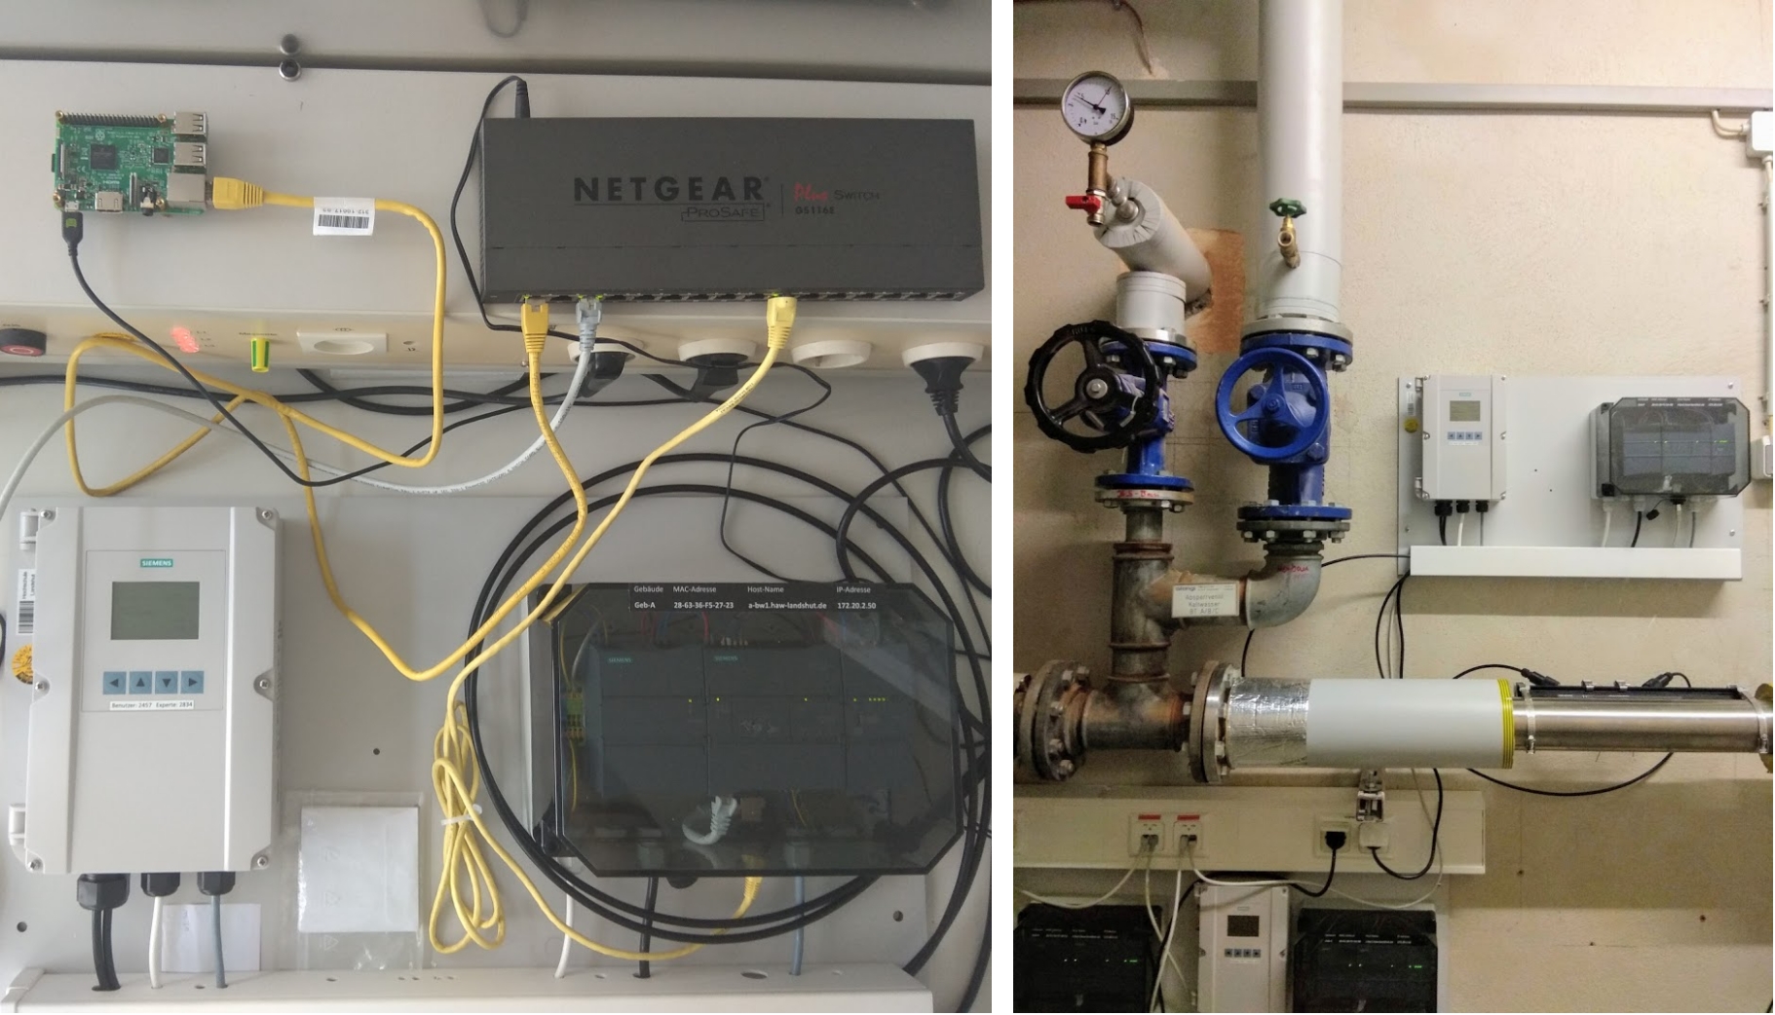
UAS Landshut
Hardware setup for the acquisition of water data at the UAS Landshut.
Notes:
This is how the hardware setup for the acquisition of water data look like at the UAS Landshut.
The left image shows the laboratory test setup, while the right images shows the system in production.
There is the ResPi as the concentrator, receiving real time data from the siemens controller.
We send the datagrams every minute to the AWS endpoint. ->

Slide 9
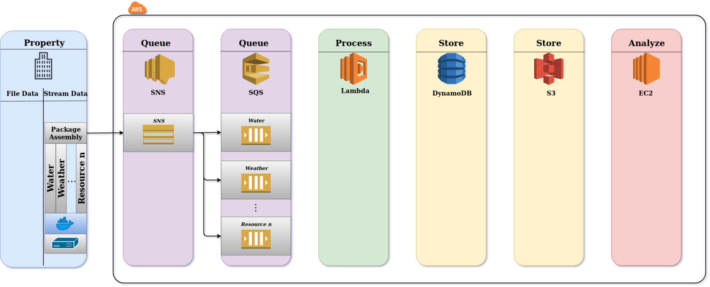
Queue
Simple Notification Service (SNS)
Simple Queue Service (SQS)
Single entrance point
Resource as Topic
SQS queues that are specific to the energy type, consume the data from the SNS queue.
Notes:
The Selena endpoint is implemented using AWS SNS, a highly scalable publish-subscribe system.
Resource types are used as publish topic and for each type an AWS SQS is set up as subscriber to that topic.
SQS queues are durable, which ensures that the Queueing stage is independent.
Currently we have configured one SQS queue for each resource type.
We do this both for performance reason but mostly for ease of configuration and maintainability.
Only those queues need to be configured that correspond to energy types that are relevant for the organization.
For each SQS queue a function is set up to process the incoming data. ->

Slide 10
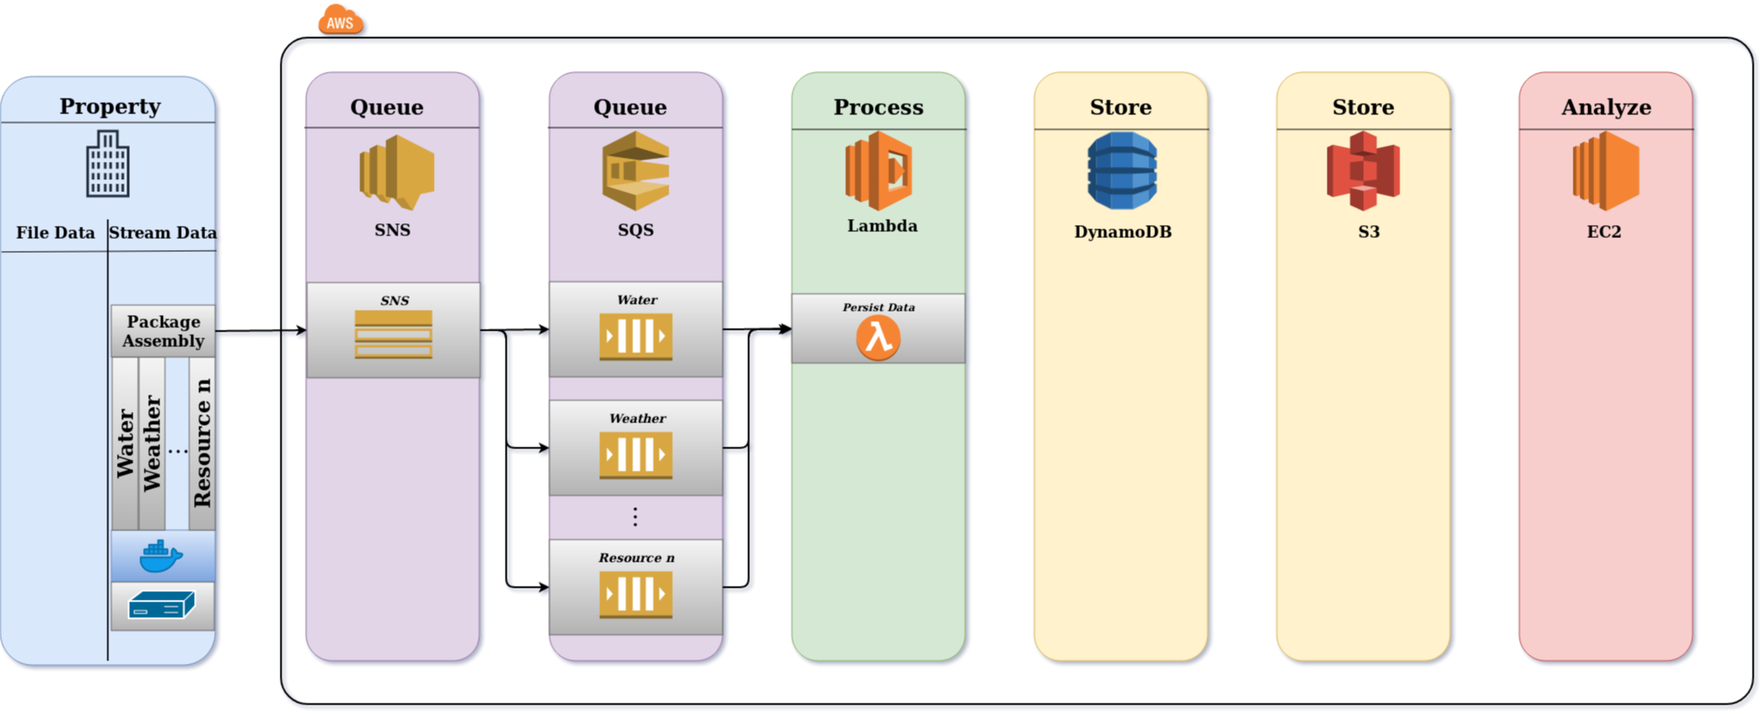
Processing
Core component
Single lambda function
“Persist Data” function
Code is only 50 lines
SQS queues which trigger Lambda functions that process and store the data.
Notes:
Hooking up AWS Lambda, Amazons serverless compute platform, to the SQS queues leads to a graceful scaling without over-provisioning or bottlenecking.
Since we have designed our own union data types using Thrift, a single Lambda function can be used to persist all data packages.
This functions is implemented with around 50 lines of python code, what makes it easily maintainable for everyone.
The function stores the data in DynamoDB ->

Slide 11
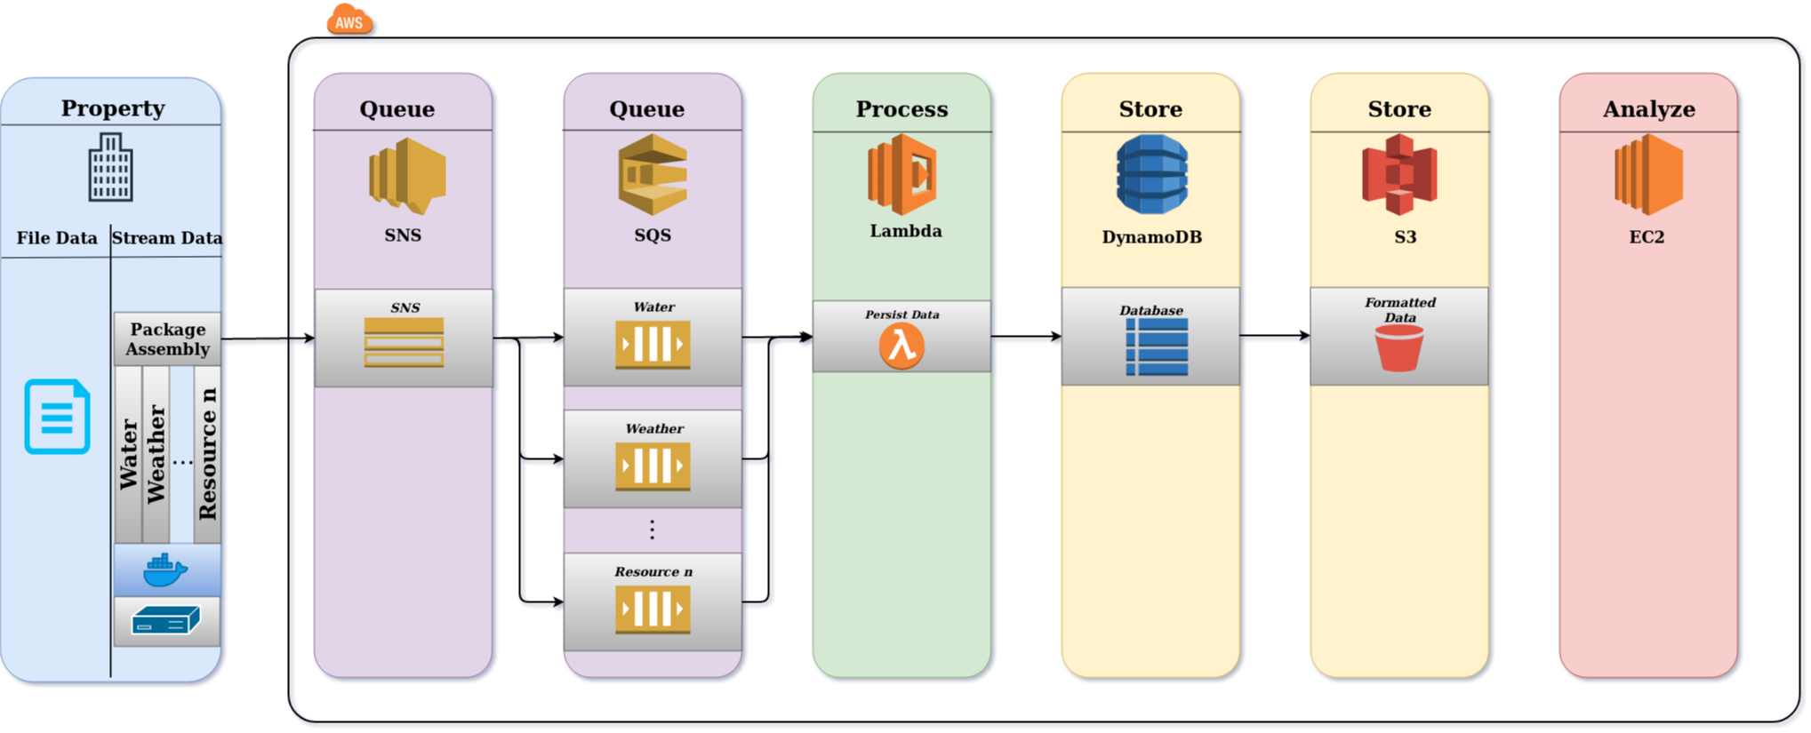
Store
DynamoDB as main storage
Fast access
Stream data
Efficient storing in S3
AWS DynamoDB as hot data storage and s3 for the cold data.
Notes:
Selena is using two different storage technologies.
DynamoDB for the hot ingress data and s3 for the cold data.
S3 provides extremely cost-effective persistent storage.
On the other hand, we have chosen AWS DynamoDB as it is both highly scalable and provides fast and efficient access for real-time monitoring and data analysis, which is crucial for providing low latency data visualization and analysis.->

Slide 12
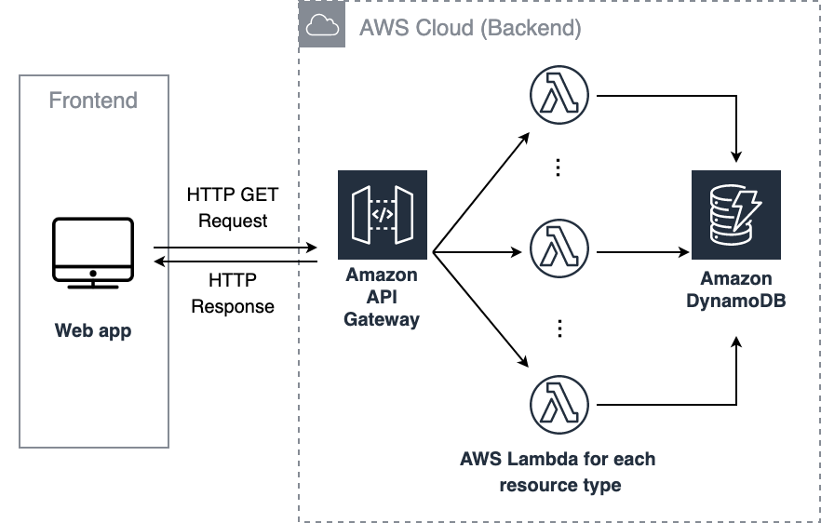
Visualization
AWS API Gateway
Microservice approach
Graphical UI runs on EC2
Selena front-to-backend communication
Notes:
Visualization and analysis is the goal of the Selena frontend.
For portability and since even non-IT people are generally familiar with a web browser, the UI is implemented as a web application.
The web application is currently running on an EC2 instance and communicates with the Selena backend through the AWS API Gateway.
A Microservice approach allow us to modularize the addition of additional energy sources as well as sites under management.
The frontend is currently the only non-serverless component. ->

Slide 13
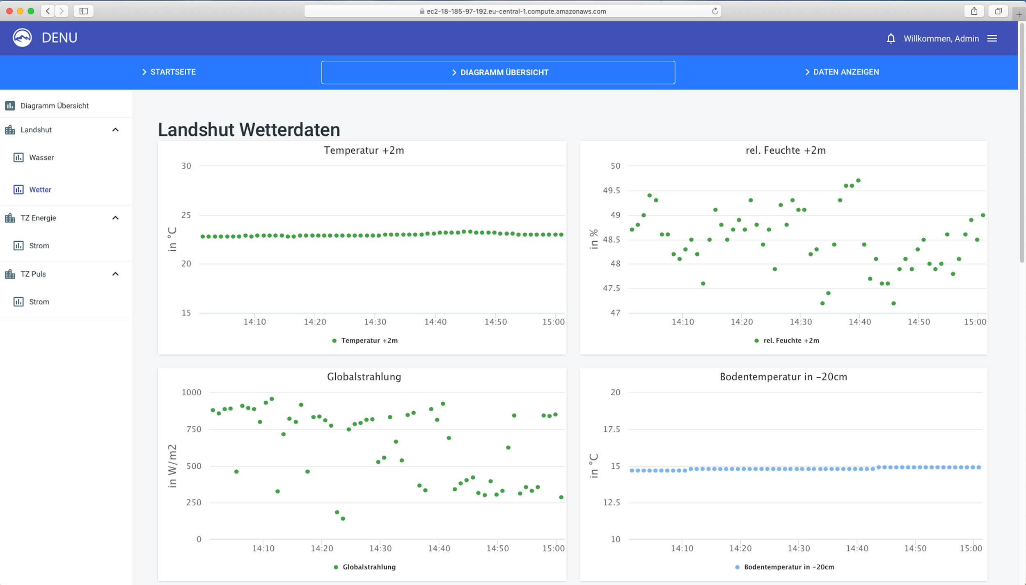
Frontend
Implementation based on:
React
Highcharts
Different user roles
Selena frontend dashboard. Visualization of a specific resource type and site.
Notes:
The implementation is based on React and Highcharts as the main Javascript and charting libraries.
The image shows an unrestricted view available for the superuser, the only role currently implemented.
But our design provides for different user roles, with different permissions and default views into the data to respect privacy and regulatory restrictions.
We are also interested in estimating the cost of operating Selena>

Slide 14
Estimated Costs
For the Ingress:
60 data point/minute
Running 24/7
200 Device less than $25 per month
Notes:
Therefore we made an estimate that is based on these assumptions:
Each sensor produce data in second intervalles
The data package size is 60 measurement points before it will be send to SNS.
Running 24/7
For our university environment, we expect about 200 devices once the system is wholly deployed, resulting in operational costs of less than 25$ per month.
Rapping everything up ->

Slide 15
Conclusion
Severless architecture
Scales naturally
Operational costs are low
Notes:
We have presented Selena, an implementation of an EMS that is build on AWS Lambda serverless platform.
We have shown how the serverless paradigm facilitates a solution that scales naturally with the number of sites as well as the number of connected sensors.
The system already supports a variety of energy and resource types and the operational costs are low and scale well up and down with the number of measurement devices.
As we have just begun with the development of selena, we are planning further features in the future.->

Slide 16
Future work
Front-end based on Zappa
Implement data analysis
Real-time alerting system
Notes:
Beside adding more instrumented sides, we want to explore how well Selena’s serverless architecture supports more complicated data analysis.
For instance we are currently implementing anomaly detection with ARIMA.
We also want to replace the front-end with a serverless framework like zappa.

Slide 17
Acknowledgments
My special thanks go to Mr. Nikolai Koerber and Prof., PhD Markus Mock from the University of Applied Sciences Landshut.
Furthermore, we thank the Federal Ministry of Economics and Technology of Germany for supporting the research.

Slide 18
Thank You

